Slide 1
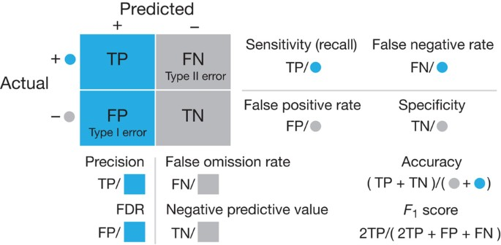
Evaluating Classification Models
Beyond Accuracy—Knowing When Your Model is Truly Successful
Instructor: Zaryab Ahmad Khan

Slide 2
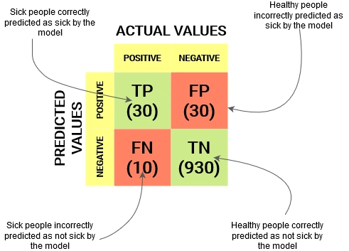
The Confusion Matrix
Definition: A simple 2x2 grid that shows exactly where the model's predictions match the actual data and where it got "confused".
The Four Quadrants:
True Positive (TP): Predicted "Yes," and it was "Yes".
True Negative (TN): Predicted "No," and it was "No".
False Positive (FP): Predicted "Yes," but it was actually "No" (False Alarm).
False Negative (FN): Predicted "No," but it was actually "Yes" (Missed Opportunity).

Slide 3
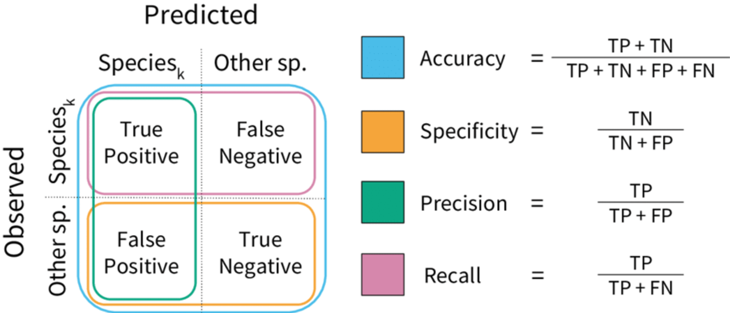
Accuracy vs. Precision vs. Recall
Accuracy: The percentage of total correct guesses. This can be misleading if your dataset is uneven.
Precision: "When the model says 'Yes,' how often is it right?" Important for avoiding false alarms (e.g., Spam filters).
Recall: "Out of all the actual 'Yes' cases, how many did the model find?"
The Priority: In medical screening, Recall is more important because missing a sick person (False Negative) is dangerous.

Slide 4
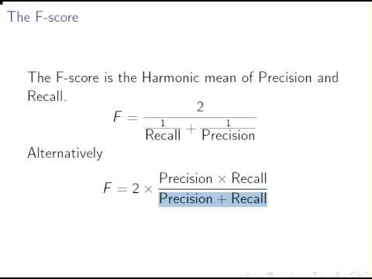
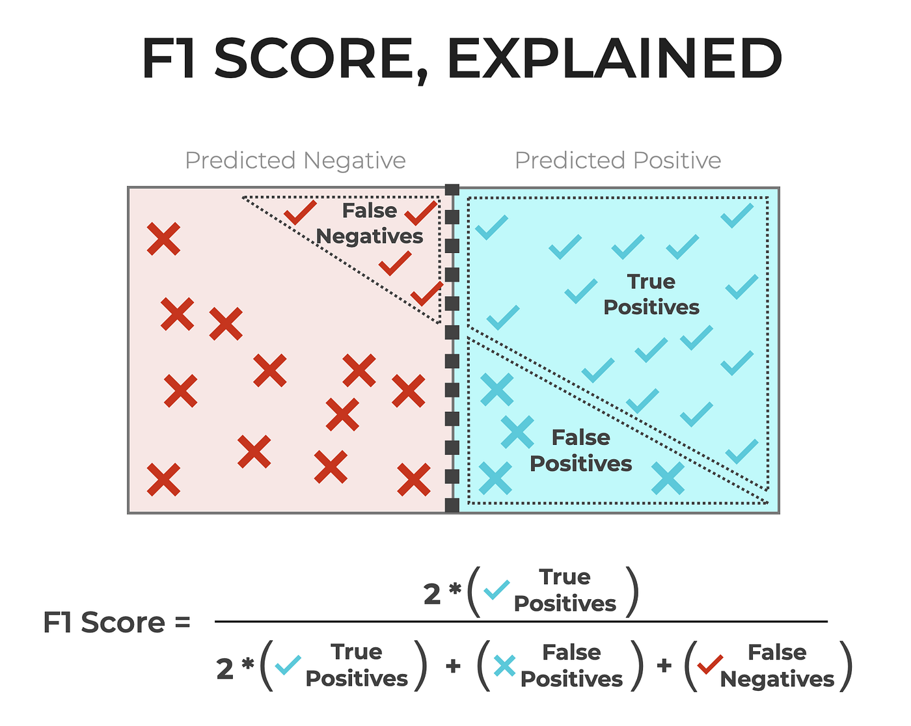

The F1-Score
Concept: A combined score that balances both Precision and Recall into a single number.
Usage: Use this when you have an uneven dataset (e.g., 99% of people are healthy, and only 1% are sick).
Formula:
$F1=2⋅\frac{Precision⋅Recall}{Precision+Recall}$

